Slide 1
Access Points

Slide 2
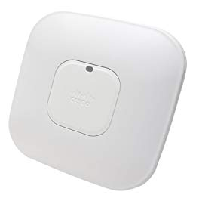
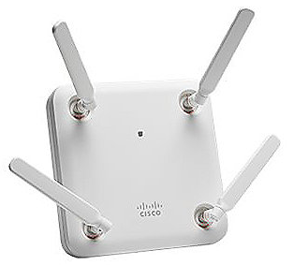
Access point
Wireless Access Point (WAP)
Layer 2 device
Bridge between wired/wireless networks
Not a wireless router
Wireless router is both a WAP and a router (Layer 3)
WAP in a single device
Notes:
Q: Why are most WAPs flat and white? A: Usually ceiling mounted in most installations (blends in with ceilings), and since most ceiling are white... Q: Why are most ceilings white? A: _________ ? ____________

Slide 3

SSID Management
SSID - Service Set Identifier
Name of the wireless network
LINKSYS, DEFAULT, NETGEAR
Change SSID to something other than default
Disable SSID broadcasting?
Never intended as security feature
SSID can be determined through analyzing wireless traffic
“Security through obscurity” is not really security

Slide 4

MAC filtering
Media Access Control
Limits access through hardware address
Keeps the neighbors, lightweights out
Easy to pull valid MAC addresses through wireless analysis
Spoof working MAC address and you’re in
“Security through obscurity”

Slide 5

Power level controls
Use as little power as necessary
What is “necessary”?
Signal coverage
User locations
Consider the users’ location
Where are users typically?
How far from access point?
High-gain antennas can help shape direction of signal

Slide 6
Band selection and bandwidths
Throughput
Maximum theoretical throughputs
Actual throughput can vary widely
Frequency
2.4GHz and 5GHz
Sometimes both
Distance
A combination of antennas
Channels
Differences in geographical location
Non-overlapping channels would be ideal

Slide 7
Band selection
 | Throughput* | Frequency
802.11a | 54Mbps | 5GHz
802.11b | 11Mbps | 2.4GHz
802.11g | 54MBps | 2.4GHz
802.11n | 300Mbps / 900Mbps | 2.4GHz / 5GHz
802.11ac | 500Mbps per channel | 2.4GHz / 5GHz
Maximum theoretical throughputs (Actual throughput may vary)
Ensure non-overlapping channels are used when possible
Channels 1, 6, and 11 do not overlap

Slide 8
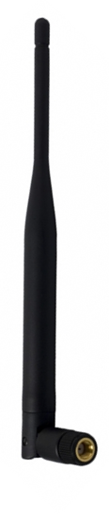
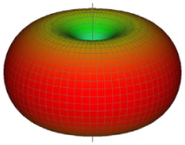
Omni directional antennas
Most common
Signal distributed in all directions
Signal radiates and comes in on long side of antenna (not tip)
Good enough for most users
No ability to focus the signal
Different antenna required to “steer” signal

Slide 9
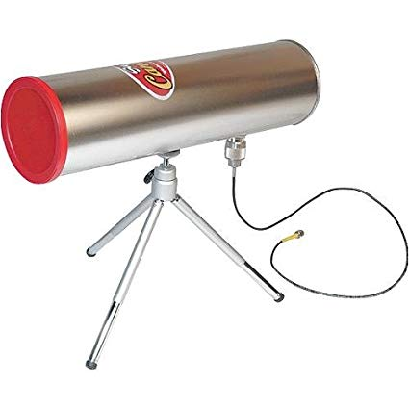
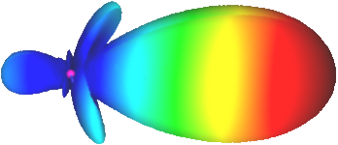
Directional antennas
Focus the signal, increase distance
Send and receive in a single direction
Rejects signal in opposite direction
Antenna performance measured in dB
3dB of gain = 2x power

Slide 10
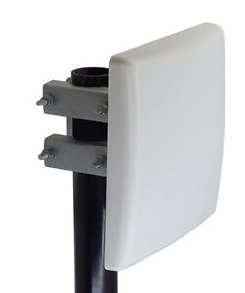
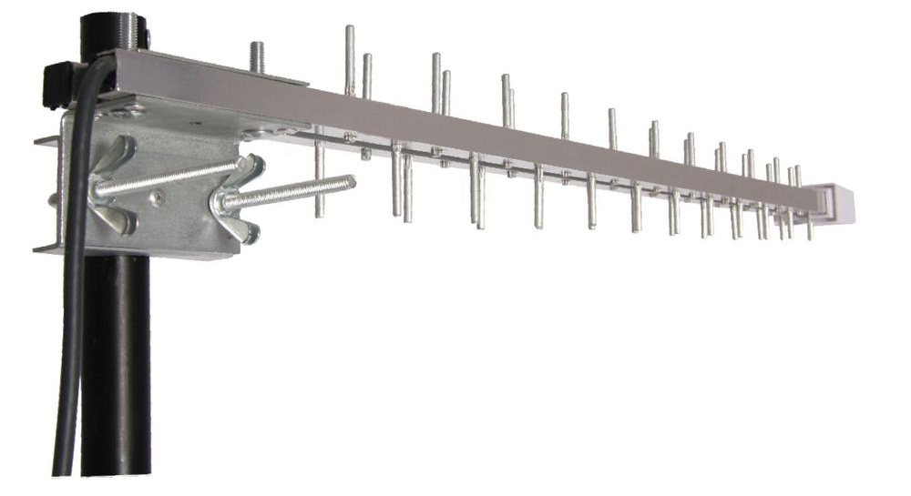
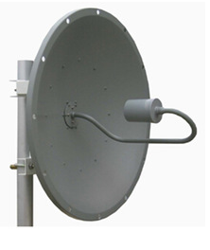
Directional antenna types
Patch antenna
Roughly 180° pattern
Directional, high gain
Yagi antenna
Narrow beam
Very directional, higher gain
Parabolic dish antenna
Focused signal, down to a single point
Highly directional, highest gain

Slide 11



Wireless controllers
Manage WAPs from central location
Configure and deploy changes to all sites at once
Easy to add more access points
Monitor all wireless activity from one point
WAP
WAP
WAP
WAP
WAP
Switch
Wireless controller

Slide 12
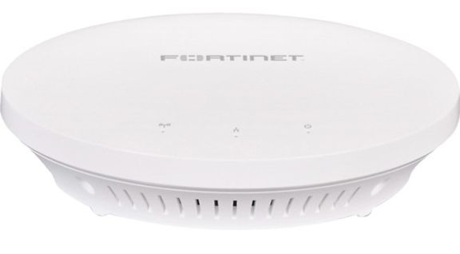
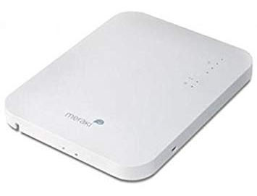
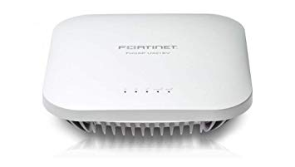
Wireless configurations
Fat access points
Access point handles all wireless
Less administrative load on switch
More expensive
Thin access points
Radio transceiver in device and that’s it
Administrative load is back at switch
Less expensive

